Slide 1
Graph Algorithms
Fall 2024
School of Software Engineering
South China University of Technology

Slide 2

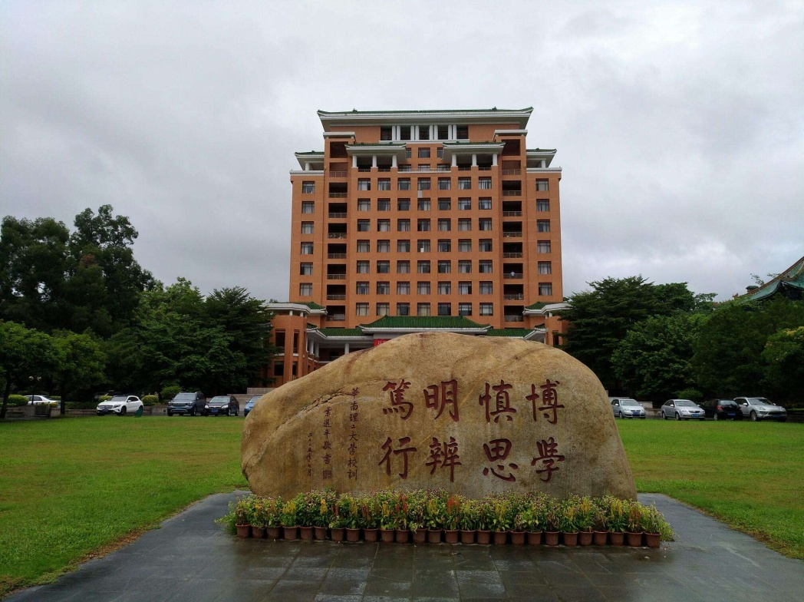
Shortest-Path Algorithms
Section 9.3

Slide 3
Recall Path cost ,Path length
Path cost: the sum of the costs of each edge
Path length: the number of edges in the path
Path length is the unweighted path cost
Peking
4
Shanghai
2
2
2
2
Wuhan
3
2
3
Xian
Guangzhou
length(p) = 5
cost(p) = 11

Slide 4

Shortest Path Problems
Given a graph G = (V, E) and a “source” vertex s in V, find the minimum cost paths from s to every vertex in V
Single-Source Shortest Paths problem
Many variations:
unweighted vs. weighted
cyclic vs. acyclic
pos. weights only vs. pos. and neg. weights
etc
Notes:
The problem that Dijkstra’s algorithm addresses is the single source, shortest path problem.
Given a graph and a source vertex, find the shortest path from the source to every vertex.
We can put a variety of limitations or spins on the problem.
We’ll focus on weighted graphs with no negative weights.
This is used in all sorts of optimization problems: minimum delay in a network, minimum cost flights for airplane routes, etc.

Slide 5
Why study shortest path problems?
Traveling on a budget: What is the cheapest airline schedule from Guangzhou to city X?
Optimizing routing of packets on the internet:
Vertices are routers and edges are network links with different delays. What is the routing path with smallest total delay?
Shipping: Find which highways and roads to take to minimize total delay due to traffic
etc.

Slide 6
Unweighted Shortest Path
Problem: Given a “source” vertex s in an unweighted directed/undirected graph
G = (V,E), find the shortest path from s to all vertices in G
Only interested in path lengths
A
B
F
H
Source
G
C
D
E
Notes:
Now, can we handle unweighted graphs?
How might we implement this?
Breadth first search!
Will it work for weighted graphs?
No. It won’t.
What about Depth First search?
Clearly not that either.
What about the third search we studied? Best first search?
That won’t quite work, but it might if we counted the path cost in with the edge cost.
Let’s come back to that.

Slide 7
Breadth-First Search Solution
Basic Idea: Starting at node s, find vertices that can be reached using 0, 1, 2, 3, …, N-1 edges (works even for cyclic graphs!)
A
B
F
H
G
C
D
E

Slide 8
Breadth-First Search Algorithm
Uses a queue to track vertices that are “nearby”
source vertex is s
Running time = O(|V| + |E|)
Distance[s] := 0
Enqueue(Q,s);
Mark(s); //After a vertex is marked once
// it won’t be enqueued again
while queue is not empty do
X := Dequeue(Q);
for each vertex Y adjacent to X do
if Y is unmarked then
Distance[Y] := Distance[X] + 1;
Previous[Y] := X; //if we want to record paths
Enqueue(Q,Y);
Mark(Y);

Slide 9
Example: Shortest Path length
A
B
F
H
0
G
C
D
E
Queue Q = C

Slide 10
Example (ct’d)
1
B
A
F
H
0
G
1
C
D
E
1
Queue Q = A D E
Indicates the vertex is marked
Previous pointer

Slide 11
Example (ct’d)
2
1
A
B
F
H
0
G
1
C
D
E
1
Q = D E B

Slide 12
Example (ct’d)
2
1
A
B
F
H
0
G
2
1
C
D
E
1
Q = B G

Slide 13
Example (ct’d)
2
3
1
A
B
F
H
0
G
2
1
C
D
E
1
Q = F

Slide 14
Example (ct’d)
2
3
4
1
A
B
F
H
0
G
2
1
C
D
E
1
Q = H

Slide 15
Weighted Shortest Path
What if edges have weights?
Breadth First Search does not work anymore
minimum cost path may have more edges than minimum length path
2
3
A
B
F
H
1
1
2
3
1
9
4
G
8
C
2
D
E
1
3
from C to A
Shortest path (length) = C→A (cost = 9)
Minimum Cost Path = C→E→D→A (cost = 8)

Slide 16
Dijkstra’s Algorithm
Classic algorithm for solving Single-Source Shortest Paths in weighted graphs (without negative weights)
A greedy algorithm (irrevocably makes decisions without considering future consequences)
Notes:
Dijkstra’s algorithm is a greedy algorithm (like Huffman encoding), so it just makes the best local choice at each step.
The choice it makes is which shortest path to declare known next.
It starts by declaring the start node known to have a shortest path of length 0. Then, it updates neighboring node’s path costs according to the start node’s cost.
Then, it just keeps picking the next shortest path and fixing that one until it has all the vertices.

Slide 17
Dijkstra其人
Dijkstra 的全名叫 Edsger Wybe Dijkstra（艾兹赫尔·韦伯·戴克斯特拉）。大部分中国程序员如果能记住这个名字是因为学过计算最短路径的「Dijkstra 算法」，然而大部分人都难以记住正确的拼写，因为他是荷兰人，名字不符合英语的发音规则。
Int* d; Int i, j, k; char* str; Double a;
dijkstra
1994 年时有人对约 1000 名计算机科学家进行了问卷调查，选出了 38 篇这个领域最有影响力的论文，其中有五篇是 Dijkstra 写的

Slide 18
Dijkstra 在鹿特丹长大。在高中毕业前他想在法学界发展，并且希望将来能在联合国做荷兰的代表。然而因为他毕业时数学、物理、化学、生物都是满分，老师和父母都劝他选择科学的道路，后来他选择学习理论物理
在大学期间，世界上最早的电子计算机出现了，他父亲让他到剑桥大学参加一个程序设计的课程。从这里开始，他的程序设计生涯开始了。一段时间以后他决定转向计算机程序设计，因为他认为相对于理论物理，程序设计对智力是更大的挑战。程序设计是最无情的，每一个一和零都容不得差错。
他在阿姆斯特丹的数学中心成为了一个兼职的程序员。他的工作是为一些正在被设计制造的计算机编写程序，也就是说他要用纸和笔把程序写出来，验证它们的正确性，和负责硬件的同事确认需要的指令是可以被实现的，并写出计算机的规范说明。他为并不存在的机器写了五年程序

Slide 19
物理学家们觉得他是逃兵，而数学家们也看不起他和他做的事，因为在当时的数学文化里，你的课题必须和 ∞ 有关才会受尊重。那个时候程序设计没有成为一个职业，没有人能说出这个行业的基础知识体系是什么，而这些都会被 Dijkstra 改变。1957 年，他结婚的时候在申请的职业一栏写上了「程序员」，结果被政府拒绝，因为当时荷兰没有这个职业
在一台新的叫 ARMAC 的计算机发布之前，Dijkstra 需要想出一个可以让不懂数学的媒体和公众理解的问题，以便向他们展示。有一天他和未婚妻在阿姆斯特丹购物，他们停下来在一家咖啡店的阳台上喝咖啡休息，他开始思考这个问题。他觉得可以让计算机演示如何计算荷兰两个城市间的最短路径，这样问题和答案都容易被人理解。于是他在 20 分钟内想出了高效计算最短路径的方法。Dijkstra 自己也没有想到这个 20 分钟的发明会成为他最著名的成就之一，并且会被以他的名字命名为 Dijkstra 算法。

Slide 20
Dijkstra 后来在采访中说，他的最短路径算法之所以能如此简洁，是因为当时在咖啡店里没有纸和笔，这强迫他在思考时避免复杂度，尽可能追求简单。在他的访谈和文章中，经常能发现一个主题，就是资源的匮乏往往最能激发创造性

Slide 21
Basic Idea of
Dijkstra’s Algorithm
Find the vertex with smallest cost that has not been “marked” yet.
Mark it and compute the cost of its neighbors.
Do this until all vertices are marked.
Note that each step of the algorithm we are marking one vertex and we won’t change our decision: hence the term “greedy” algorithm

Slide 22
Dijkstra’s Shortest Path Algorithm
Initialize the cost of s to 0, and all the rest of the nodes to ∞
Initialize set S to be ∅
S is the set of nodes to which we have a shortest path
While S is not all vertices
Select the node A with the lowest cost that is not in S and identify the node as now being in S
for each node B adjacent to A
if cost(A)+cost(A,B) < B’s currently known cost
set cost(B) = cost(A)+cost(A,B)
set previous(B) = A so that we can remember the path

Slide 23
Example: Initialization
0
∞
Cost(source) = 0
2
Cost(all vertices but source) =
v₁
v₂
∞
4
1
3
10
v₃
2
v₄
2
v₅
∞
∞
8
∞
4
5
6
v₆
1
v₇
∞
∞
Pick vertex not in S with lowest cost in every step.
S | 1 | 2 | 3 | 4 | 5 | 6 | 7
{} | 0 | ∞ | ∞ | ∞ | ∞ | ∞ | ∞
initial

Slide 24
Example: Update Cost neighbors
0
2
Update Cost neighbors of the picked vertex V1.
v₁
2
v₂
4
1
3
10
v₃
2
v₄
2
v₅
∞
∞
8
1
4
Cost(v2) = 2
Cost(v4) = 1
5
6
v₆
1
v₇
∞
∞
S | 1 | 2 | 3 | 4 | 5 | 6 | 7
{} | 0 | ∞ | ∞ | ∞ | ∞ | ∞ | ∞
{1} | 0 | 2 | ∞ | 1 | ∞ | ∞ | ∞

Slide 25
Example
0
2
pick vertex with lowest cost and add it to S
v₁
2
v₂
4
1
3
10
v₃
2
v₄
2
v₅
∞
∞
8
1
4
5
6
v₆
1
v₇
∞
∞
S | 1 | 2 | 3 | 4 | 5 | 6 | 7
{} | 0 | ∞ | ∞ | ∞ | ∞ | ∞ | ∞
{1} | 0 | 2 | ∞ | 1 | ∞ | ∞ | ∞

Slide 26
Example
0
2
v₁
2
v₂
4
1
3
10
update neighbors
v₃
2
v₄
2
v₅
3
3
5
8
1
4
6
Cost(v3) = 1 + 2 = 3
Cost(v5) = 1 + 2 = 3
Cost(v6) = 1 + 8 = 9
Cost(v7) = 1 + 4 = 5
v₆
1
v₇
9
5
S | 1 | 2 | 3 | 4 | 5 | 6 | 7
{} | 0 | ∞ | ∞ | ∞ | ∞ | ∞ | ∞
{1} | 0 | 2 | ∞ | 1 | ∞ | ∞ | ∞
{1,4} | 0 | 2 | 3 | 1 | 3 | 9 | 5

Slide 27
Example
0
2
v₁
2
v₂
4
1
3
10
update neighbors
v₃
2
v₄
2
v₅
3
3
5
8
1
4
6
v₆
1
v₇
9
5
S | 1 | 2 | 3 | 4 | 5 | 6 | 7
{} | 0 | ∞ | ∞ | ∞ | ∞ | ∞ | ∞
{1} | 0 | 2 | ∞ | 1 | ∞ | ∞ | ∞
{1,4} | 0 | 2 | 3 | 1 | 3 | 9 | 5
{1,4,2} | 0 | 2 | 3 | 1 | 3 | 9 | 5

Slide 28
Example
0
2
v₁
2
v₂
4
1
3
10
v₃
2
v₄
2
v₅
3
3
5
8
1
4
6
1
No updating
v₆
v₇
9
5
S | 1 | 2 | 3 | 4 | 5 | 6 | 7
{} | 0 | ∞ | ∞ | ∞ | ∞ | ∞ | ∞
{1} | 0 | 2 | ∞ | 1 | ∞ | ∞ | ∞
{1,4} | 0 | 2 | 3 | 1 | 3 | 9 | 5
{1,4,2} | 0 | 2 | 3 | 1 | 3 | 9 | 5
{1,4,2,5} | 0 | 2 | 3 | 1 | 3 | 9 | 5

Slide 29
Example
0
2
v₁
2
v₂
4
1
3
10
v₃
2
v₄
2
v₅
3
3
5
8
1
4
6
update neighbors
v₆
1
v₇
8
5
S | 1 | 2 | 3 | 4 | 5 | 6 | 7
{} | 0 | ∞ | ∞ | ∞ | ∞ | ∞ | ∞
{1} | 0 | 2 | ∞ | 1 | ∞ | ∞ | ∞
{1,4} | 0 | 2 | 3 | 1 | 3 | 9 | 5
{1,4,2} | 0 | 2 | 3 | 1 | 3 | 9 | 5
{1,4,2,5} | 0 | 2 | 3 | 1 | 3 | 9 | 5
{1,4,2,5,3} | 0 | 2 | 3 | 1 | 3 | 8 | 5

Slide 30
Example
0
2
v₁
2
v₂
4
1
3
10
v₃
2
v₄
2
v₅
3
3
5
8
1
4
6
update neighbors
v₆
1
v₇
6
5
S | 1 | 2 | 3 | 4 | 5 | 6 | 7
{} | 0 | ∞ | ∞ | ∞ | ∞ | ∞ | ∞
{1} | 0 | 2 | ∞ | 1 | ∞ | ∞ | ∞
{1,4} | 0 | 2 | 3 | 1 | 3 | 9 | 5
{1,4,2} | 0 | 2 | 3 | 1 | 3 | 9 | 5
{1,4,2,5} | 0 | 2 | 3 | 1 | 3 | 9 | 5
{1,4,2,5,3} | 0 | 2 | 3 | 1 | 3 | 8 | 5
{1,4,2,5,3,7} | 0 | 2 | 3 | 1 | 3 | 6 | 5

Slide 31
Example
S | 1 | 2 | 3 | 4 | 5 | 6 | 7
{} | 0 | ∞ | ∞ | ∞ | ∞ | ∞ | ∞
{1} | 0 | 2 | ∞ | 1 | ∞ | ∞ | ∞
{1,4} | 0 | 2 | 3 | 1 | 3 | 9 | 5
{1,4,2} | 0 | 2 | 3 | 1 | 3 | 9 | 5
{1,4,2,5} | 0 | 2 | 3 | 1 | 3 | 9 | 5
{1,4,2,5,3} | 0 | 2 | 3 | 1 | 3 | 8 | 5
{1,4,2,5,3,7} | 0 | 2 | 3 | 1 | 3 | 6 | 5
{1,4,2,5,3,7,6} | 0 | 2 | 3 | 1 | 3 | 6 | 5
0
2
v₁
2
v₂
4
1
3
10
v₃
2
v₄
2
v₅
3
3
5
8
1
4
6
update neighbors
v₆
1
v₇
6
5

Slide 32
Dijkstra’s Algorithm
- Implementation
//Implementation of Dijkstra’s algorithm
//compute shortest path dists from “s”
void Dijkstra(Graph* G, int* D, int s) {
int i, v, w;
for (int i=0; i<G->n(); i++) // Initialize
D[i] = INFINITY;
D[s] = 0;
for (i=0; i<G->n(); i++) { //process vertices
//find the unvisited vertex with min dist
v = minVertex(G, D);
if (D[v] == INFINITY) return; //v is unreachable
G->setMark(v, VISITED);
//update the distance of v’s neighbors
for (w=G->first(v); w<G->n(); w = G->next(v,w))
if (G->getMark(w) == UNVISITED)
if (D[w] > (D[v] + G->weight(v, w)))
D[w] = D[v] + G->weight(v, w);
}
}

Slide 33
Dijkstra’s Algorithm
- Implementation
minVertex – find the unvisited vertex with minimum distance
Method 1: scan through the list of |V| vertices searching for the minimum value
int minVertex(Graph* G, int* D) {
int i, v = -1;
//initialize v to some unvisited vertex
for (i=0; i<G->n(); i++)
if (G->getMark(i) == UNVISITED) {
v = i;
break; }
// Now find smallest D value
for (i++; i<G->n(); i++)
if ((G->getMark(i) == UNVISITED) && (D[i] < D[v]))
v = i;
return v;
}

Slide 34
Dijkstra’s Algorithm
- Implementation
Complexity analysis of method 1
minVertex executes |V| times, and it scans the list of |V| vertices each time.
The cost is Θ (|V|²)
The edges are processed Θ (|E|) times, and each visit to an edge may cause a constant-time update to the array D.
The cost is Θ (|E|)
In total, the cost is Θ (|V|²+|E|)= Θ (|V|²)

Slide 35
Dijkstra’s Algorithm
- Implementation
Method 2:
Store unprocessed vertices in a priority-queue (implemented using a min-heap) ordered by distance values.
The next-closest vertex can be found in the heap in Θ(log|V|) time
Every time D(x) is updated,
Reordered x in the heap by deleting and reinserting it.
Or, add the new smaller distance value for x as a new record in the heap
The greater distance values found later will be ignored because the vertex will already be marked as VISITED

Slide 36
Dijkstra’s Algorithm
- Implementation
// Implementation using the priority queue
// Class for elements in the heap
Class DijkElem {
Public:
int vertex, distance;
DijkElem() {vertex = -1; distance = -1;}
DijkElem(int v, int d) {vertex = v; distance = d};
};

Slide 37
//Implementation of Dijkstra’s algorithm
void Dijkstra(Graph* G, int* D, int s) {
int i, v, w; // v is current vertex
DijkElem temp; DijkElem E[G->e()]; // Heap array
for (int i=0; i<G->n(); i++) // Initialize
D[i] = INFINITY;
D[s] = 0;
// Initialize heap array
temp.distance = 0; temp.vertex = s;
E[0] = temp;
heap<DijkElem, DDComp> H(E, 1, G->e());
// get an unvisited vertex with smallest distance
for (i=0; i<G->n(); i++) {
do {
if(H.size() == 0) return; // Nothing to remove
temp = H.removefirst(); //delmin
v = temp.vertex;
} while (G->getMark(v) == VISITED);
G->setMark(v, VISITED); //mark the vertex
if (D[v] == INFINITY) return; //unreachable
for(w=G->first(v); w<G->n(); w=G->next(v,w))
if (G->getMark(w) == UNVISITED)
if (D[w] > (D[v] + G->weight(v, w))) {
//update D
D[w] = D[v] + G->weight(v, w);
temp.distance = D[w]; temp.vertex = w;
// Insert new distance in heap
H.insert(temp);
}
}
}

Slide 38
Dijkstra’s Algorithm
- Implementation
Complexity analysis of method 2
If the vertex with a smaller distance is inserted as a new record, the cost for finding the minimum value using the min-heap becomes Θ(log|E|)
It executes V times, and the cost is Θ (|V|log|E|)
Every visit to an edge cause an update to D and also the min-heap.
The cost is Θ (|E|log|E|)
In total, the cost Θ ((|V|+|E|)log|E|)

Slide 39
Correctness
Dijkstra’s algorithm is an example of a greedy algorithm
Greedy algorithms always make choices that currently seem the best
Short-sighted – no consideration of long-term or global issues
Locally optimal does not always mean globally optimal
In Dijkstra’s case – choose the least cost node, but what if there is another path through other vertices that is cheaper?

Slide 40

“Cloudy” Proof: The Idea
Least cost node
Next shortest path from inside the known cloud
G
THE MARKED
CLOUD
P
competitor
Source
If the path to G is the next shortest path, the path to P must be at least as long. Therefore, any path through P to G cannot be shorter!

Slide 41
Inside the Cloud (Proof)
Everything inside the cloud has the correct shortest path
Proof is by induction on the number of nodes in the cloud:
Base case: Initial cloud is just the source s with shortest path 0.
Inductive hypothesis: Assume that a cloud of k-1 nodes all have shortest paths.
Inductive step: choose the least cost node G → has to be the shortest path to G (previous slide). Add k-th node G to the cloud.
Reference：https://en.wikipedia.org/wiki/Dijkstra's_algorithm#Proof_of_correctness
Notes:
To polish this off, note that it’s an inductive proof.
Proof of Dijkstra's algorithm is constructed by induction on the number of visited nodes.
Invariant hypothesis: For each node v, dist[v] is the shortest distance from source to v when traveling via visited nodes only, or infinity if no such path exists. (Note: we do not assume dist[v] is the actual shortest distance for unvisited nodes.)
The base case is when there is just one visited node, namely the initial node source, in which case the hypothesis is trivial.
Otherwise, assume the hypothesis for n-1 visited nodes. In which case, we choose an edge (v,u) where u has the least dist[u] of any unvisited nodes and the edge (v,u) is such that dist[u] = dist[v] + length[v,u]. dist[u] is considered to be the shortest distance from source to u because if there were a shorter path, and if w was the first unvisited node on that path then by the original hypothesis dist[w] > dist[u] which creates a contradiction. Similarly if there were a shorter path to u without using unvisited nodes, and if the last but one node on that path were w, then we would have had dist[u] = dist[w] + length[w,u], also a contradiction.
After processing u it will still be true that for each unvisited node w, dist[w] will be the shortest distance from source to w using visited nodes only, because if there were a shorter path that doesn't go by u we would have found it previously, and if there were a shorter path using u we would have updated it when processing u.
After all nodes are visited, the shortest path from source to any node v consists only of visited nodes, therefore dist[v] is the shortest distance.
Here’s the other problem with negative weights.
A negative weight could make it actually better to wander outside the cloud for a while instead of going straight to a new unknown node.

Slide 42
To polish this off, note that it’s an inductive proof.
Proof of Dijkstra's algorithm is constructed by induction on the number of visited nodes.
Invariant hypothesis: For each node v, dist[v] is the shortest distance from source to v when traveling via visited nodes only, or infinity if no such path exists. (Note: we do not assume dist[v] is the actual shortest distance for unvisited nodes.)
The base case is when there is just one visited node, namely the initial node source, in which case the hypothesis is trivial.

Slide 43
U
V
S
W
W
Otherwise, assume the hypothesis for n-1 visited nodes. In which case, we choose an edge (v,u) where u has the least dist[u] of any unvisited nodes and the edge (v,u) is such that dist[u] = dist[v] + length[v,u]. dist[u] is considered to be the shortest distance from source to u because if there were a shorter path, and if w was the first unvisited node on that path then by the original hypothesis dist[w] > dist[u] which creates a contradiction.
Similarly if there were a shorter path to u without using unvisited nodes, and if the last but one node on that path were w, then we would have had dist[u] = dist[w] + length[w,u], also a contradiction.

Slide 44
After processing u it will still be true that for each unvisited node w, dist[w] will be the shortest distance from source to w using visited nodes only, because if there were a shorter path that doesn't go by u we would have found it previously, and if there were a shorter path using u we would have updated it when processing u.
After all nodes are visited, the shortest path from source to any node v consists only of visited nodes, therefore dist[v] is the shortest distance.

Slide 45
Graphs with Negative Edge Costs
If the graph has negative edge costs, then Dijkstra’s algorithm does not work.
v₁
210
v₂
S | 1 | 2 | 3 | 4 | 5
{} | 0 | ∞ | ∞ | ∞ | ∞
{1} | 0 | 210 | ∞ | 100 | 20
{1,5} | 0 | 210 | ∞ | 100 | 20
{1,5,4} | 0 | 210 | 70 | 100 | 20
{1,5,4,3} | 0 | 210 | 70 | 100 | 20
{1,5,4,3,2} | 0 | 210 | 70 | 100 | 20
100
-150
20
v₄
20
60
-30
60
v₅
v₃
10

Slide 46
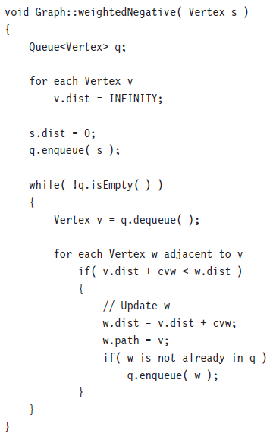

Slide 47
Graphs with Negative Edge Costs
If the graph has negative edge costs, then Dijkstra’s algorithm does not work.
v₁
210
v₂
Q | 1 | 2 | 3 | 4 | 5
{1} | 0 | ∞ | ∞ | ∞ | ∞
{2,4,5} | 0 | 210 | ∞ | 100 | 20
{4,5,3} | 0 | 210 | 230 | 60 | 20
{5,3} | 0 | 210 | 30 | 60 | 20
{3} | 0 | 210 | 30 | 60 | 20
{0} | 0 | 210 | 30 | 60 | 20
100
-150
20
v₄
20
60
-30
v₅
v₃
10

Slide 48
All Pairs Shortest Path
Given a edge weighted directed graph G = (V,E) , find for all u,v in V the length of the shortest path from u to v.
Could run the appropriate single-source algorithm |V| times.
On sparse graphs, it is fast to run |V| Dijkstra’s algorithms coded with priority queues
On dense graphs, the algorithm in textbook section 10.3.4 more faster in practice

Slide 49
Homework 7-2
Textbook Exercises 9.5

